Slide 1
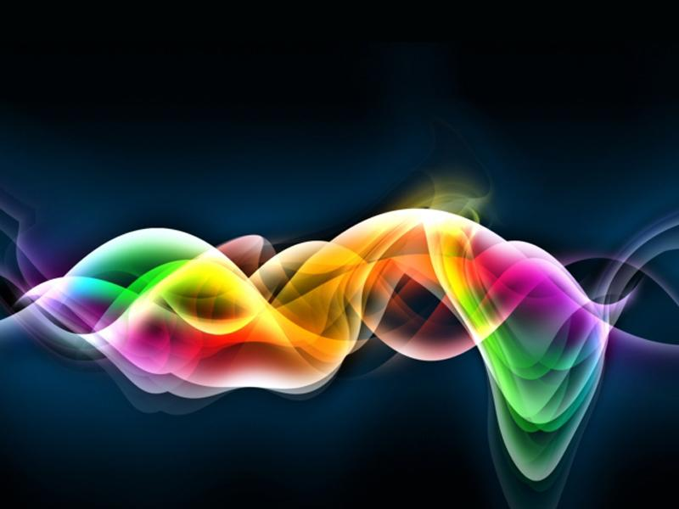
INNOVATING
ARTIFICIAL INTELLIGENCE AND MACHINE LEARNING
Free Powerpoint Templates

Slide 2
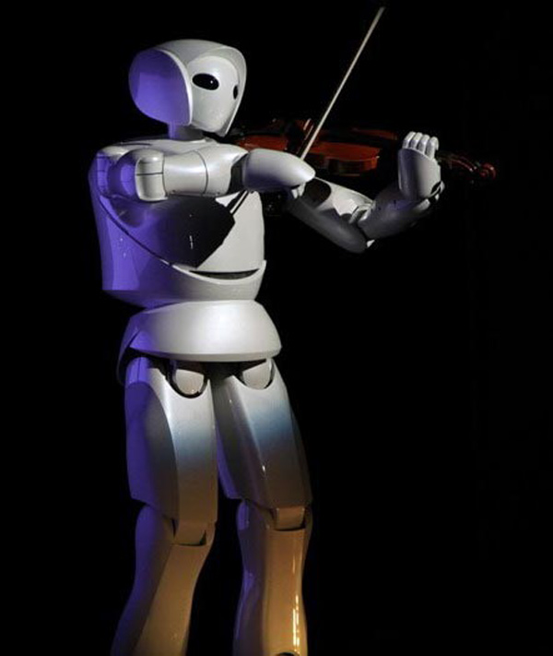
ARTIFICIAL
INTELLIGENCE
The ability of computer software and hardware to do those things that we, as humans, recognize as intelligent behaviour.

Slide 3
FOR EXAMPLE
Searching: finding “good” material from a large quantity of available data.
Recognizing patterns: finding items with similar characteristics
Surmounting constraints: finding ways that something will fit into a confined space, building a complex object, or moving through a
maze.

Slide 4
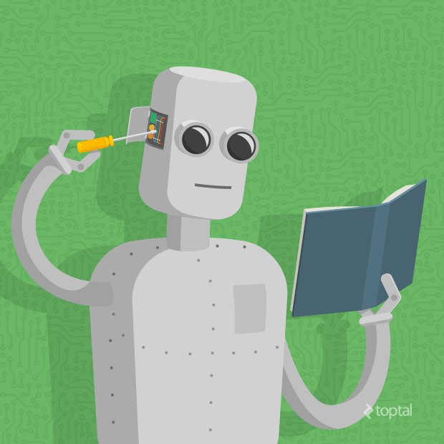
MACHINE LEARNING
A machine is trained by algorithms enabling it to learn how to perform a task on the basis of large amount of data

Slide 5
ML Leads to AI
General AI machines have remained in the movies and science fiction novels for good reason; we can’t pull it off, at least not yet
What we can do now falls into the category of “narrow AI”

Slide 6
ML Leads to AI
Image classification or Face Recognition are some good examples of “narrow AI”.
In order to achieve such kind of intelligence, machine learning acts as an approach to achieve artificial intelligence

Slide 7
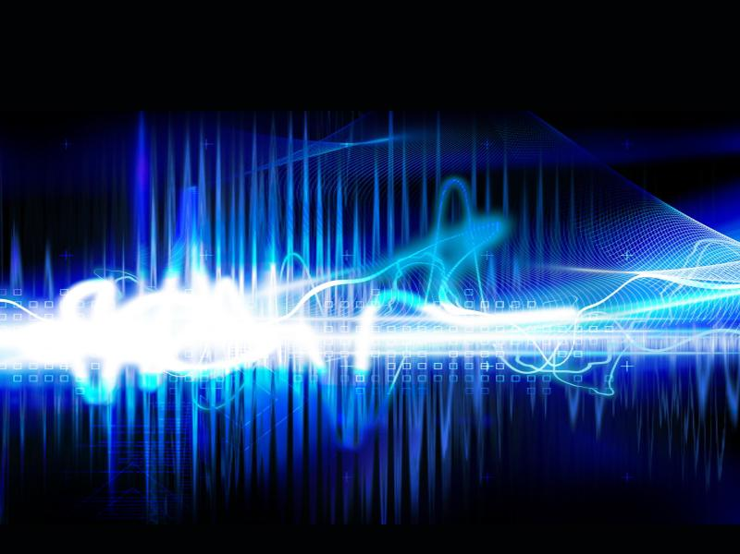
MAJOR BRANCHES OF AI

Slide 8
MAJOR BRANCHES OF AI
Robotics
Visions System
Natural Language Processing (NLP)
Neural Networks

Slide 9
Robotics
Involve developing mechanical or computer devices that perform tasks requiring a high degree of precision or that are hazardous for humans

Slide 10

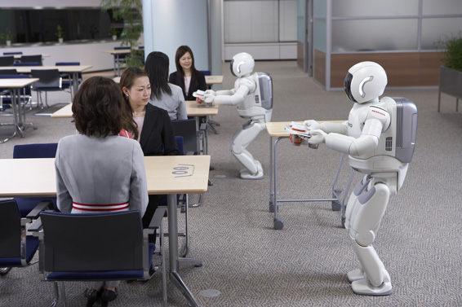
FOR EXAMPLE:- ASIMO

Slide 11
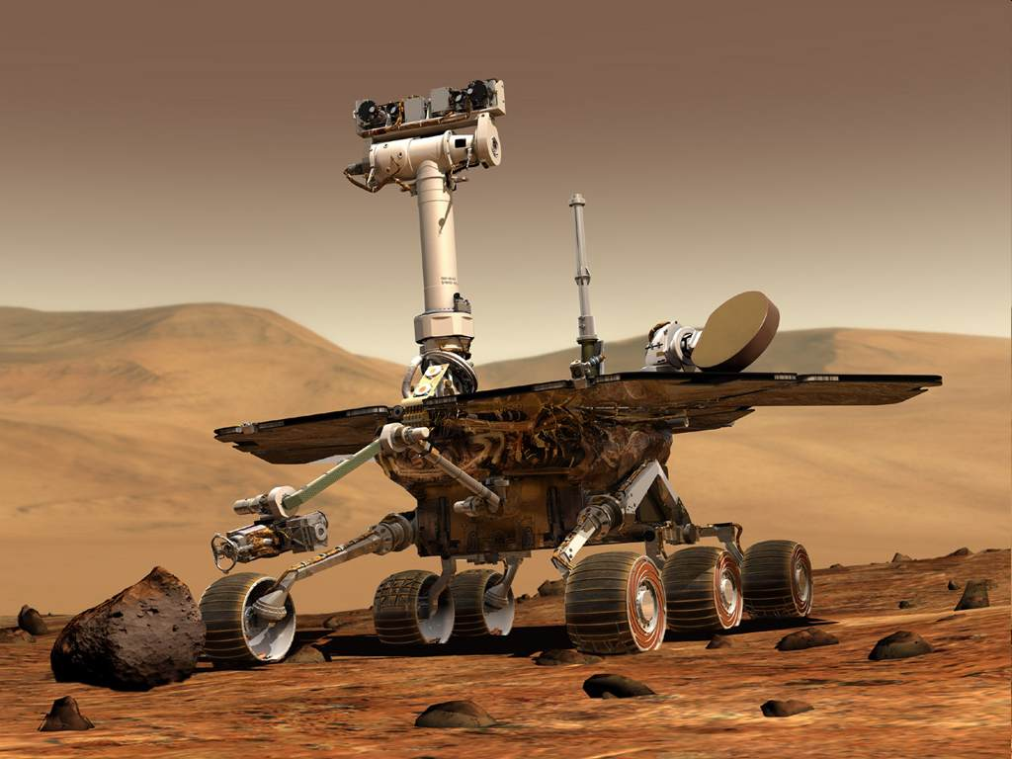
The Rover was a remote-controlled robot used by NASA to explore the surface of Mars

Slide 12
Vision Systems
Include hardware and software that permit computers to capture, store, and manipulate visual images and pictures.

Slide 13
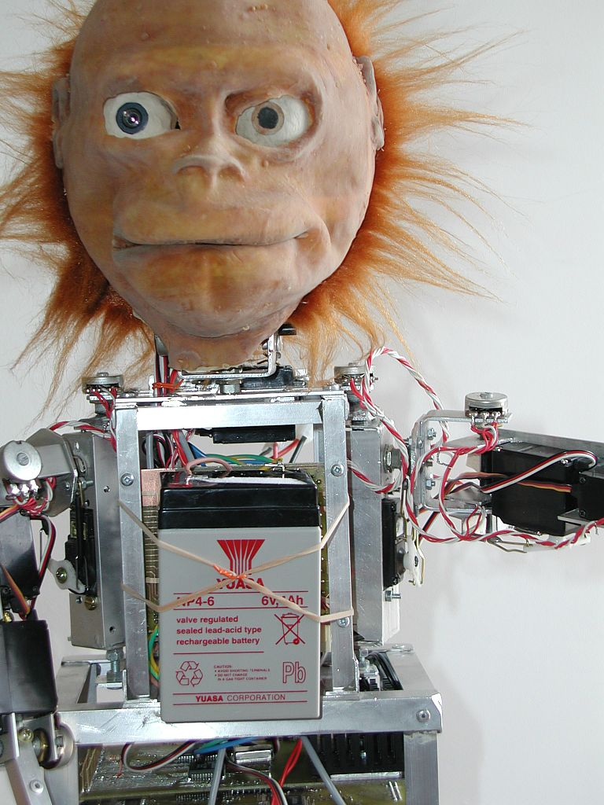
FOR EXAMPLE: Lucy
An orangutan robot, was a pure research project to develop some novel theories about the fundamental operating principles of the brain

Slide 14
Natural Language Processing
Computers understand and react to statements and commands made in a “natural” language, such as English
Machine translation: based on a large corpus like wiki, companies could train translation machine from one language to another
Question answering: Siri is one of the questions answering models that we are familiar with
In the healthcare sector, patients with less serious illness could consult with online “doctors” to get immediate and proper instruction by input their medication history and symptoms

Slide 15
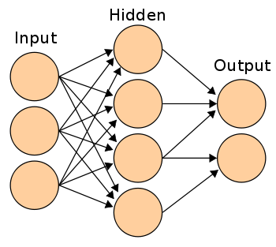
Artificial Neural Networks Computer system that can act like or simulate the functioning of the human brain

Slide 16
ADVANTAGES
Artificial intelligence wouldn't need any sleep and have unemotional considerations of problems
The Process of Automation of task is easily Posibble. Based on user’s past search, Google and Facebook are using machine learning to present relevant advertisements
Due to machine learning there are tools available to provide continuous quality improvement in large and complex process environments
Machine learning is used to handle multi-dimensional and multi-variety data in dynamic environments

Slide 17
DISADVANTAGES
If robots start replacing human resources in every field, we will have to deal with serious issues like unemployment
Intelligent machines may not be the right choice for customer service.
Intelligent machines overpower human beings
Limited sensory input, an artificial mind is only capable of taking in a small amount of information

Slide 18
CHALLANGES
Acquisition of relevant data is the major challenge. Based on different algorithms data need to be processed before providing as input to respective algorithms. This has significant impact on results to be achieved or obtained
Interpretation of results is also a major challenge to determine effectiveness of machine learning algorithms
Based on which action to be taken and when to be taken, various machine learning techniques are need to be tried
Who’s to blame when a software or hardware malfunctions? Before AI, it was relatively easy to determine whether an incident was the result of the actions of a user, developer or manufacturer

Slide 19

CONCLUSION
“Don't be afraid of Technology” by Prof Kris Singh
Please watch the video clip

Slide 20
A short Vido Clip about AI

Slide 21
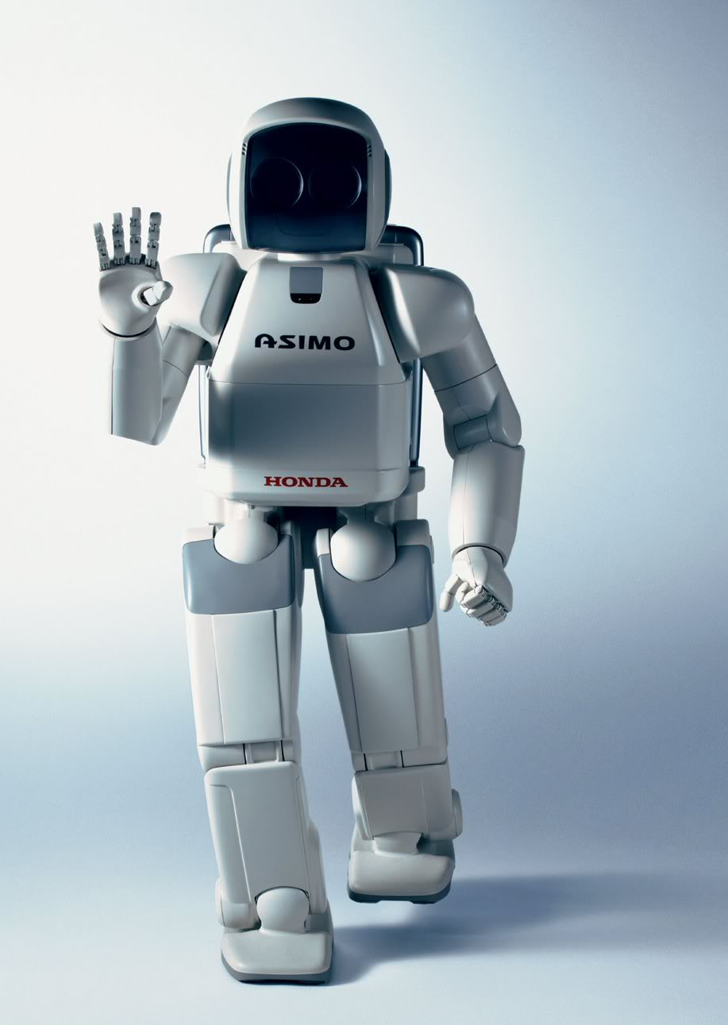
T
H
A
N
K
Y
O
U

Slide 22
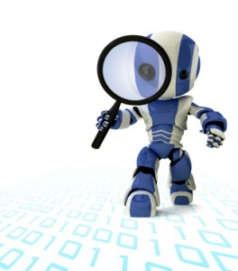
ANY QUERY ?

